Slide 1
Date Here
UNDERSTAND COVID-19 VACCINATION RATE
WHAT’S LIMITING US?
Jessie Lee, Ambikha Maharaj, Charan Musunuru, Karthick Ramasubramanian
TEAM 15 , The University of Texas at Austin

Slide 2
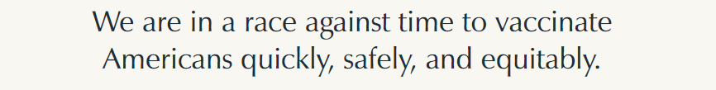
THE HEADLINE
In February 2021, CDC study predicted the concerns in some states for vaccination roll out
Now we know the vaccination rate at this stage, we can recalibrate ourselves to the most current data
This exercise is to update our prediction model to fit the current vaccination result and understand the limiting factors that has high impact on the vaccination rate
Notes:
We need every state and county in the United States to vaccinate their citizens. But historical trends show that we should expect different challenges to getting shots in arms, depending on where people live. To increase vaccine coverage across communities, we can’t take a one-size-fits-all approach. The COVID-19 Vaccine Coverage Index (CVAC) can help. By drilling down to the county level, the CVAC shows precisely which barriers each U.S. community is likely to face in achieving high vaccine coverage and why, so we can develop targeted solutions to help them.

Slide 3
OUTLINE
Datasets Used
Data Exploration
Modeling
– What are the Important Factors of Vaccination Progress
Conclusion

Slide 4
DATASETS
No concern
Low
Medium
High
COVID Vaccination Status (CDC)
Vaccination Hesitation Index
(CDC)
Population and demographic data
(US Census Bureau)
Nationwide Religion and Index (Pew Research)
2020 US Presidential Election
(MIT ElectionLab)
Vaccine Coverage Index
(CDC)
Religious Landscape Study
(Pew Research）
Th1_Historic_Undervaccination
Th2_Sociodemographic_Barriers Th3_Resource_constrained_Healthcare_SystemTh4_Healthcare_Accessibility_Barriers Th5_Irregular_Care_Seeking_Behavior
General religious status:
Religious index
Religious ranking
Democratic
Republican
Specifics about religion
% of people who believe in god
religious activity such as pray, go to church…
Notes:
We used the vaccination administration dataset from CDC up to 7/31 and the census data from US census dataset to computer the vaccination rate.
Using these dataset, we want to gain insights into the vaccination rate distribution among states/counties, and the demographic distribution among the vaccinated people.
To help understand the vaccination data, we also pull the COVID 19 vaccine hesitance index data from CDC at county level, which is
'Th2_Lack of Access to Infomation', 'Th2_Socio-economically disadvantaged', 'Th3_Low Healthcare System Capacity', 'Th3_Weak Healthcare System', 'Th4_Barriers due to cost', 'Th4_Barriers due to Transportation', 'Th5_Lack of Designated Medical Home', 'Th5_Lack of Routine Care Visits'],

Slide 5
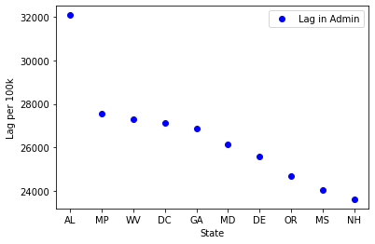
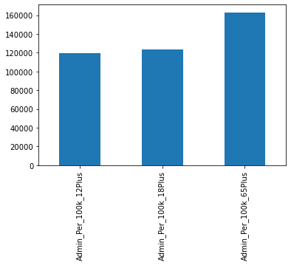
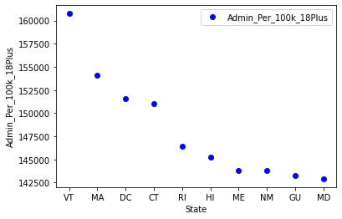
DATA EXPLORATION
States with highest and lowest vaccination rate

Slide 6
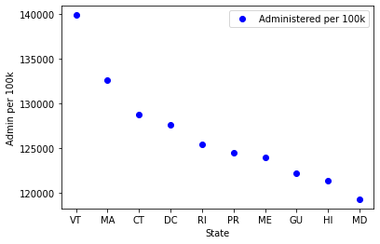
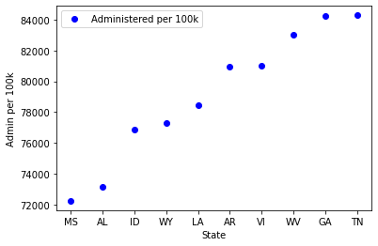

Slide 8
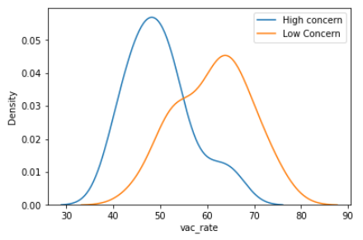
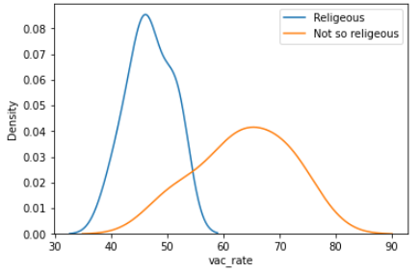
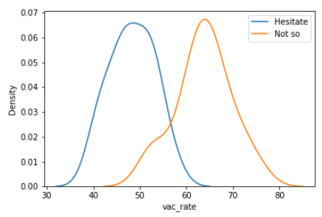
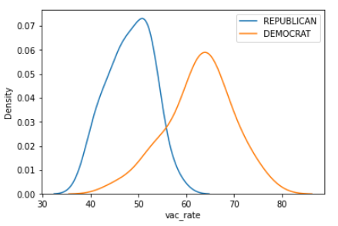
WHAT MATTER?
Vaccination rate is more of a concern for states that:
Have over all poor coverage concerns from the medical facilities and historic vaccination concerns
Religious
Right leaning in political belief
More people said they are hesitate to get vaccine (so obvious here almost redundant!)

Slide 9
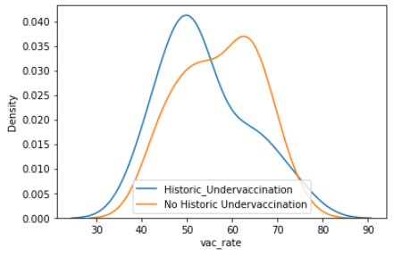
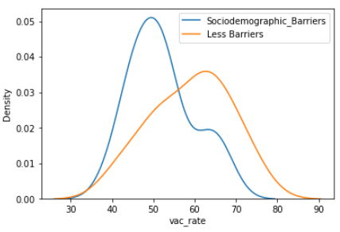
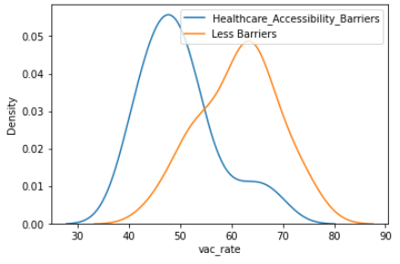
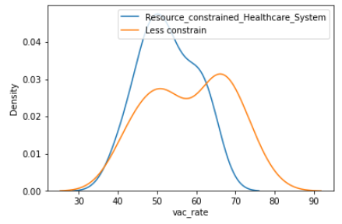
SOME MEDICAL ‘CONCERNS’
Some sub medical themes are better predictor than the other
Less of a concern?
Sociodemographic barrier
Historic under vaccination
Resource constrain
More of a concern?
Accessibility
Irregular care seeking behavior

Slide 10
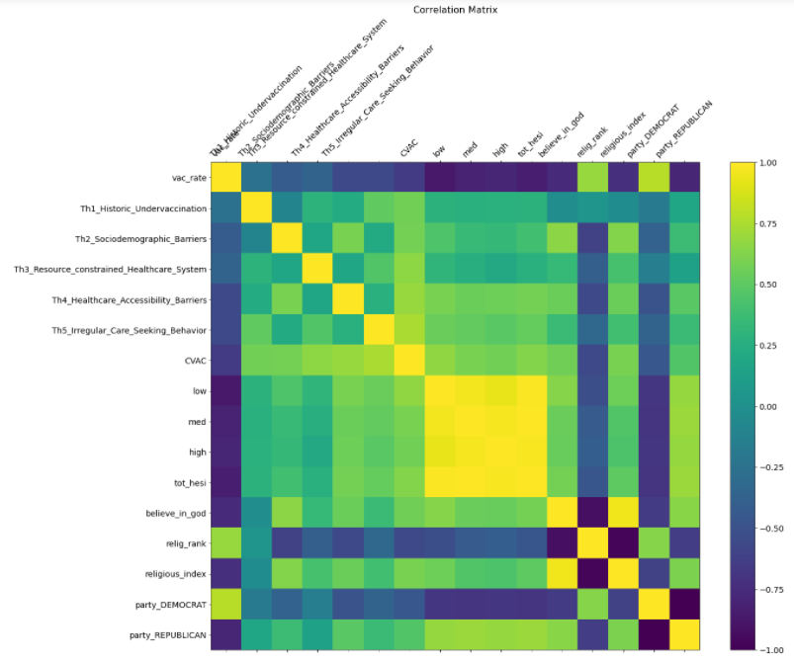
CORRELATION
2 main predictor groups:
Medical related themes
Behavior themes
Hesitation
Religion
Political belief

Slide 11

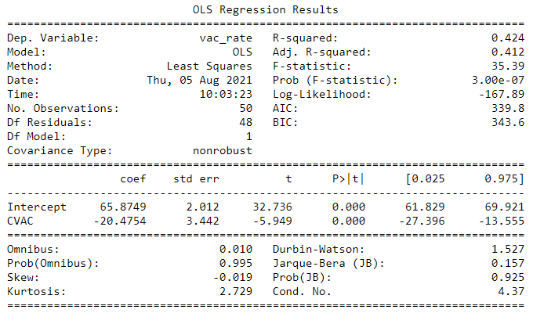
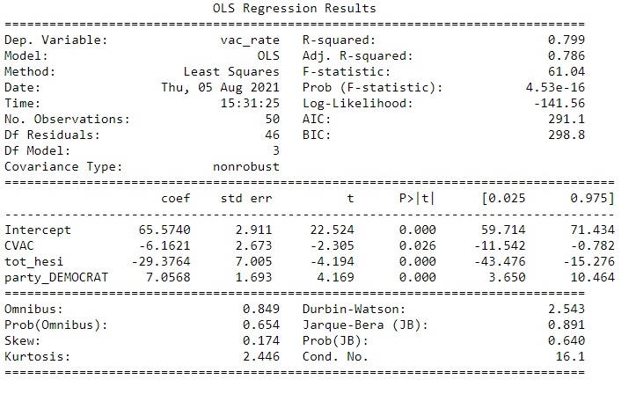
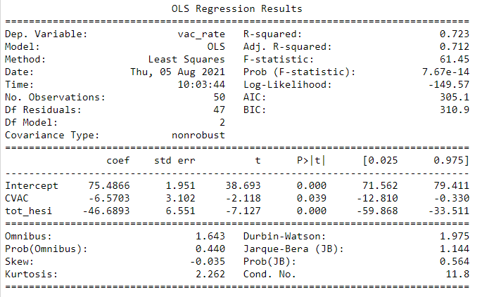
LINEAR REGRESSION
Use only medical themes
All sub-themes, R2=99%
Adding hesitation, R² increased…
Adding political themes, R² increased further…

Slide 12
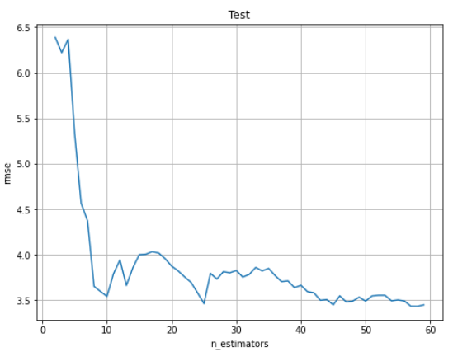
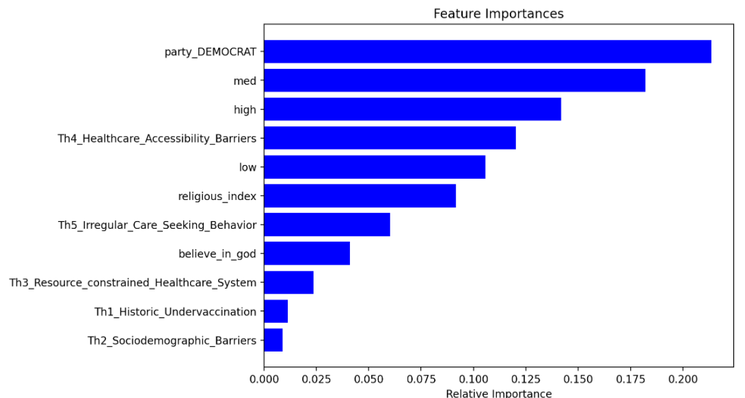
RANDOM TREE
Parameters were optimized for final model
n_estimators=10
max_depth=5
max_leaf_nodes=20

Slide 13
CONCLUSION
The current vaccination RATIO

Slide 14
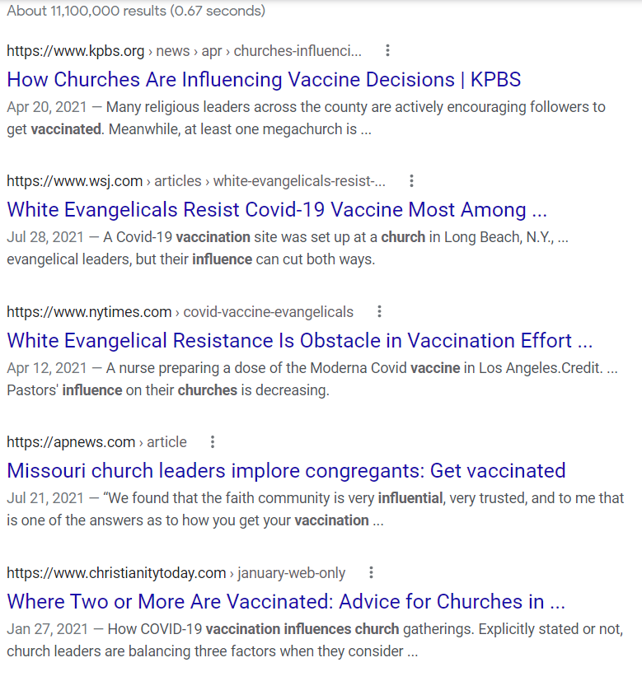
Let’s look at reality and think about potential actions

Slide 15
Thank you!

Slide 20
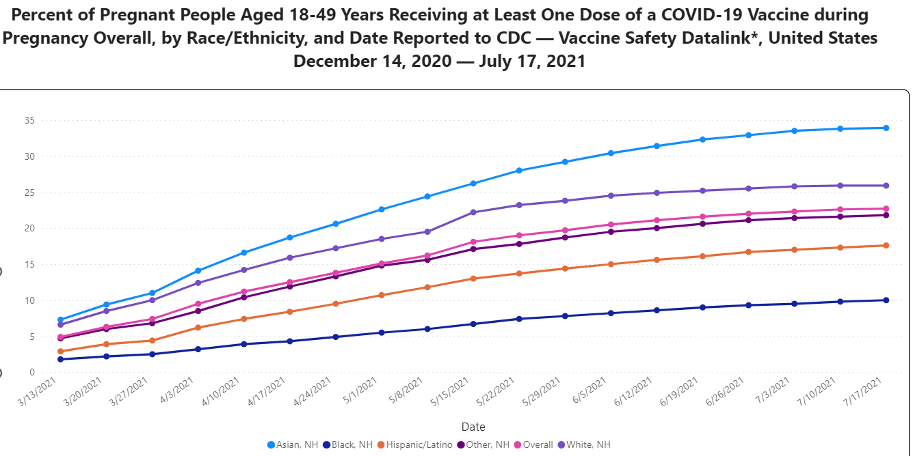

Slide 21
KEEP YOUR SLIDES CONSISTENT.
Use McCombs branded fonts, Arial and Georgia.

Slide 22
Association of Religion Data Archives and the original collector(s) of the data (e.g., The data were downloaded from the Association of Religion Data Archives, www.TheARDA.com, and were collected by [name of principal investigator(s)].

